Slide 1
Hybrid concurrency
The end of Dennard scaling

Slide 2


Types of concurrency
We have explored two types of concurrency
Thread-based
Process-based
 | Thread | Process
No concurrency
Thread-based
Process-based
Hybrid

Slide 3
Hybrid concurrency
Hybrid concurrency uses the available hardware resources in the most efficient manner.
Use process-based concurrency (e.g. MPI) to execute one fat process on each node
Use thread-based concurrency (e.g. task-based algorithms) inside each process
Use special hardware on each node
Graphics Processing Unit (GPU)
NVIDIA
AMD/ATI
Many Integrated Core (MIC)
Intel

Slide 4
GPU Programming
A number of different extensions and standards exist for GPU programming.
CUDA
Developed by NVIDIA
Latest NVIDIA cards have ~2600 processors
OpenCL
Open standard for GPU development
Supported by NVIDIA, AMD, Intel
C++ AMP
Microsoft standard competing with OpenCL

Slide 5
Characteristics of GPU programming
All of the these GPU programming standards share common characteristics.
Special compilers
Custom libraries (e.g. memory management)
Special compiler directives
GPUs do not execute not x86 or x64 code
Why?
GPUs are not good at general purpose computing
Tend to support only inline execution, have shorter pipelines, slower clock speeds
Very good for floating point math

Slide 6
Application Architecture
Taking advantage of a GPU requires specific application architecture.
Find code that is highly parallel (Amdahl's Law)
Find processor-bound algorithms
Cost to move memory to and from the GPU
Cost of more complex source code
General purpose code will suffer when executed on the GPU
Offload model – executable runs on host, sections of code run on GPU
Bottom line: Code needs to be written for the GPU (there is still no free lunch)

Slide 7
Using a GPU with offload
Host
Computation
CPUs
GPU 1
Memory copy
CPU 1
CPU 2
GPU 2
CPU 3
CPU 4
Memory copy

Slide 8
Intel Many Integration core
Intel’s entry in this market is the Many Integrated Core (MIC) architecture.
Xeon Phi is the first MIC product released
60 general-purpose CPUs, four threads per CPU
Similar to Atom processors
Execute x86, x64 code
No out of order execution
512-bit wide registers
Special vector processing unit
No graphics output
Runs custom version of Linux on the card
Can execute Linux binaries compiled for MIC architecture

Slide 9
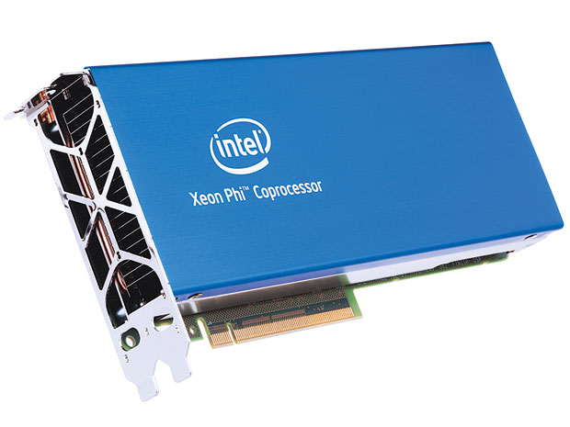
Xeon Phi

Slide 10
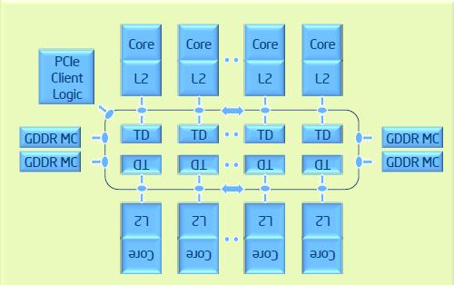
Xeon Phi Architecture

Slide 11
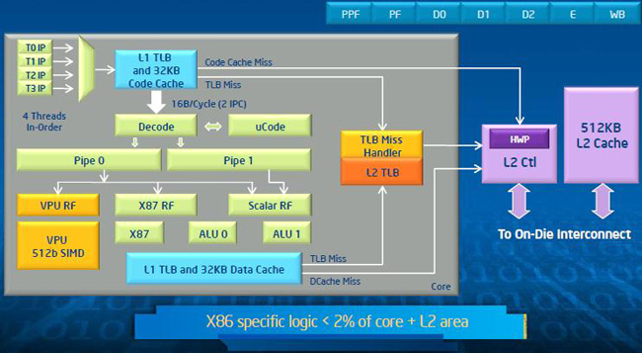
Individual Core Architecture

Slide 12
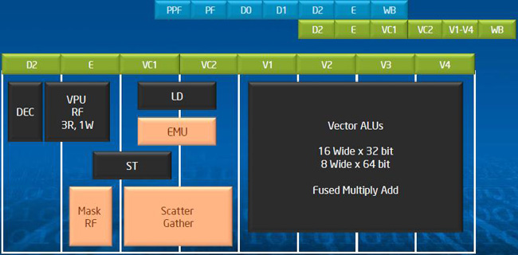
Vector Processing Unit

Slide 13
Programming for the Xeon Phi
Like other GPUs, Xeon Phi supports an offload model.
Using the Intel C++ compiler, special directives can be added to code.
Also supports native compilation
Compile an entire executable to run only on the Xeon Phi
No special directives
Concurrency support for
Intel MPI
Open MP
Intel Cilk Plus extensions
Intel Threading Build Blocks
Let’s look at an example

Slide 14
Digression: Nash solutions
The algorithm and we will explore categorizes Nash solutions.
Embarrassingly parallel
Processor-bound
Does not do floating point calculations
Implemented using Threading Building Blocks

Slide 15
Nash algorithm (6x6) on Xeon Data
Number of Threads | Actual Run Time | Linear Scalability
1 | 668.07 | 668.07
2 | 341.61 | 334.04
3 | 232.12 | 222.69
4 | 174.99 | 167.02
5 | 139.35 | 133.61
6 | 116.44 | 111.35
7 | 99.91 | 95.44
8 | 87.43 | 83.51
9 | 77.79 | 74.23
10 | 70.04 | 66.81
11 | 63.47 | 60.73
12 | 58.27 | 55.67

Slide 16
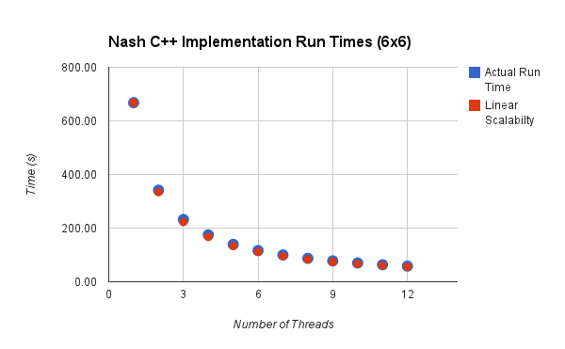
Nash algorithm (6x6) on Xeon

Slide 17
Nash algorithm (6x6) on Xeon Phi Data
Number of Threads | Actual Run Time | Linear Scalability
1 | 4,177.10 | 4,177.10
2 | 2,111.20 | 2,088.55
4 | 1,053.28 | 1,044.27
8 | 534.01 | 522.14
16 | 267.94 | 261.07
32 | 133.46 | 130.53
60 | 71.45 | 69.62
120 | 50.09 | 34.81
240 | 48.02 | 17.40

Slide 18
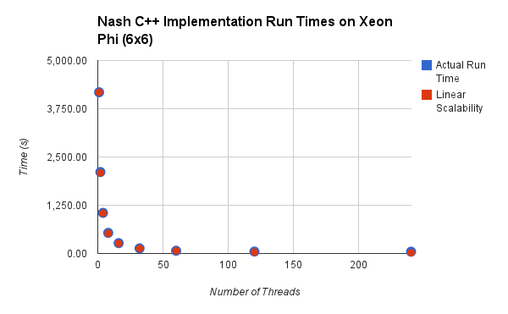
Nash algorithm (6x6) on Xeon Phi

Slide 19
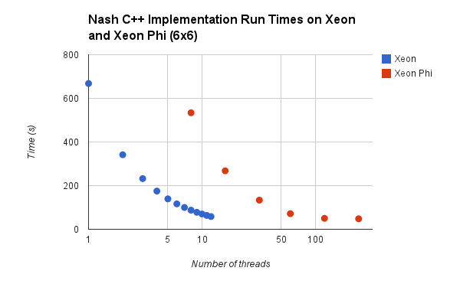
Xeon vs Xeon Phi

Slide 20
Why is this occurring?
Recall the end of Dennard scaling.
GPUs exhibit worse performance.
GPUs exhibit better performance per watt.
The near future:
More simple, slow GPU cores available
Improvement in GPU cores for general purpose code
Faster connection to GPU cores (for improved offload performance)

